Slide 1
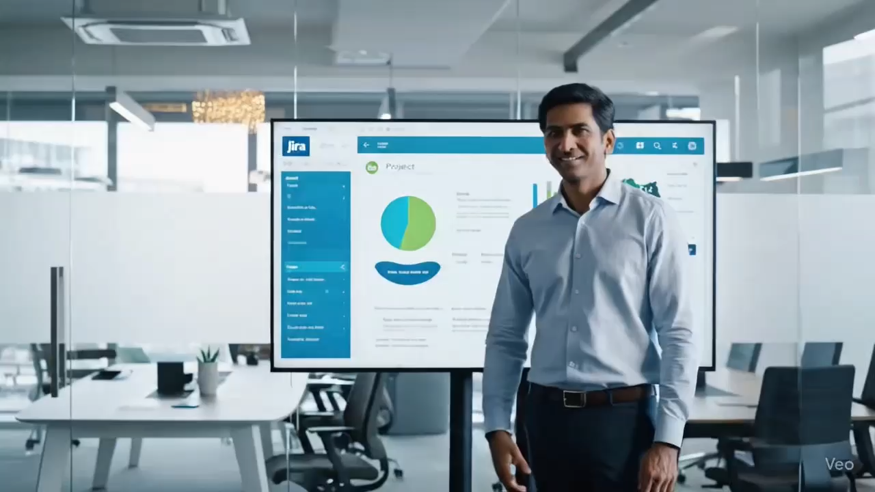

Slide 2
A well-groomed Indian man with medium-brown skin tone, neatly styled black hair, a trimmed beard, and a subtle vibhuti mark on his forehead (matching the provided reference photo), dressed in modern professional attire (navy blazer over a white shirt, no tie for a smart-casual edge). He stands at the entrance of a stylish, glass-walled conference room with warm natural lighting. He is looking directly at the camera with a welcoming, professional smile. One hand is slightly raised in a polite greeting gesture. The background includes elegant potted plants, a sleek table with a laptop open on Jira, and muted earth-tone walls. The scene captures the moment he begins his talk with the words: “Good morning, Selvam and Dennis, thank you for joining. Let’s get started.” His expression is calm, confident, and engaging, setting a respectful and professional tone for the presentation.
A man from Tamil Nadu, with medium-brown skin tone, black neatly combed hair, and a friendly, cute smile, wearing formal business attire (pressed shirt, trousers, possibly a blazer or just a crisp shirt and tie). He is giving a presentation about Jira, standing alone near a screen or whiteboard that shows Jira dashboards and charts. The camera focuses only on him. The environment is a modern Indian office setting, with neutral-colored walls, glass partitions, indoor plants, and warm lighting. Subtle elements like local art or design accents suggest an Indian corporate atmosphere rather than BNP Paribas branding. He appears confident and approachable, explaining the uses and benefits of Jira to an unseen audience.
An Indian man with medium-brown skin tone, neatly styled black hair, a trimmed beard, and a vibhuti mark on his forehead (matching the provided reference photo), dressed in formal business attire (light blue shirt, charcoal gray trousers, black belt). He stands at the front of a sleek, modern office meeting room with glass walls, a wooden conference table, and a large screen in the background displaying a subtle Jira logo. He faces the camera directly with a warm, professional smile. In this opening moment, he gestures slightly with one hand as if inviting attention, saying a thoughtful quote to set the tone: “As they say, ‘If you can’t measure it, you can’t improve it.’ Let’s see how Jira helps us do exactly that.” His expression is confident yet friendly, creating an engaging atmosphere before he begins the detailed Jira presentation. Soft indoor lighting, potted plants, and minimalist decor make the setting look premium and modern.

Slide 3
A man resembling the face in the provided photo (medium-brown skin tone, neatly groomed black hair, trimmed beard, vibhuti/white holy ash mark on forehead), wearing formal business attire (crisp shirt, tie, formal trousers). He is giving a professional, realistic presentation about Jira in a modern Indian office setting with glass partitions, neutral walls, indoor plants, and warm lighting. The camera is focused only on him—no other people in view. He has a cute, friendly smile and speaks naturally and confidently about Jira’s uses and benefits, saying things like: “This is how you can manage sprints and backlogs in Jira,” “Jira helps teams track issues efficiently,” “You can customize workflows,” and finally ending with the line: “how is the presentation Selvam and Dennis”. The teaching style is realistic, clear, and professional (not 3D or animated).
A man with medium-brown skin tone, neatly styled black hair, trimmed beard, and a vibhuti mark on his forehead (matching the provided reference photo), dressed in elegant business-casual attire (light linen shirt with rolled-up sleeves, chinos, no tie). He stands confidently on a rooftop terrace of a modern Indian office building at sunset, with the city skyline in the background. Warm golden light highlights his face as he gestures toward a sleek digital tablet in his hand that displays Jira dashboards. He is smiling naturally and explaining advanced Jira strategies, appearing calm, charismatic, and approachable. The vibe is sophisticated and aspirational, blending urban energy with professional polish. Subtle design cues (like glass railings, planters, and modern furniture) make the rooftop look upscale and contemporary.

Slide 4
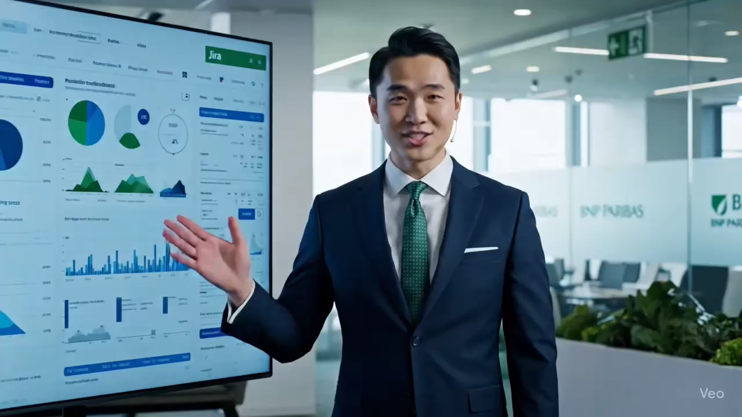

Slide 5
A professionally dressed man in formal business attire (shirt, blazer, and trousers) is standing in a modern office environment. He is speaking clearly and confidently to the camera, explaining the basics of JIRA — including its purpose, features like issue tracking, boards, workflows, and its importance in project management. He uses simple gestures, occasionally pointing to a digital screen beside him showing the JIRA dashboard, issue tickets, and Kanban boards. The tone is informative and professional. Include light background office sounds, realistic lighting, and subtle camera movements to enhance engagement.
A professional man giving a presentation about Jira in an office environment inspired by the corporate style of BNP Paribas. The man is wearing formal business attire: a tailored suit, tie, and polished shoes. He stands confidently near a large screen or whiteboard showing Jira dashboards and charts. The office has a modern corporate look with BNP Paribas-inspired aesthetics: sleek glass walls, green-themed branding elements, contemporary furniture, and natural lighting. Colleagues in business attire sit around a conference table, listening attentively. The overall atmosphere is professional, polished, and corporate.

